Slide 1
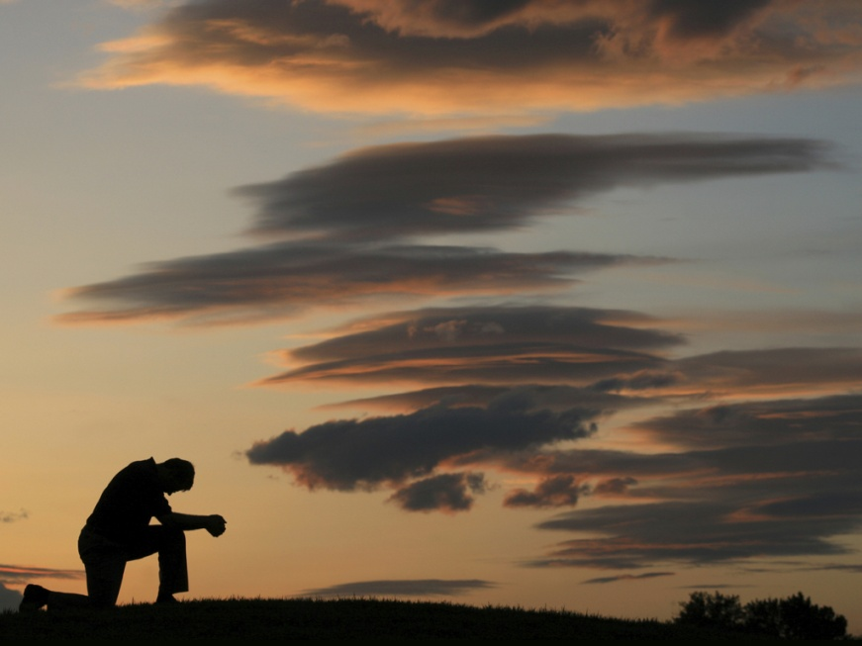
PRAY Ohio!
2014 Mission Ohio Prayer Initiative

Slide 2
PRAY Ohio!
‘The Father will never give you a template for life or ministry that eliminates the need for a daily conversation with Him.’
– Mike Harland

Slide 3
A Call to Prayer
Prayer is the Priority for Christian Living
Colossians 4:2

Slide 4
A Call to Prayer
“The one concern of the devil is to keep Christians from praying. He fears nothing from prayer-less studies, prayer-less work, and prayer-less religion. He laughs at our toil, mocks at our wisdom, but trembles when we pray.”
Samuel Chadwick

Slide 5
A Call to Prayer
Prayer is Christ’s Priority for His Church
Mark 11:17
“My house shall be called a house of prayer for all nations…”

Slide 6
A Call to Prayer
Prayer is Christ’s Priority for His Church
How are we known in the community?

Slide 7
A Call to Prayer
Prayer together is Priority for the Church
Acts 6:4 “We will give ourselves continually to prayer and the ministry of the word.”

Slide 8
A Call to Prayer
Prayer together is Priority for the Church
“The greatest workings of
God come by corporate
prayer…
John Franklin

Slide 9
A Call to Prayer
Change?
New ideas?
Unity?

Slide 10
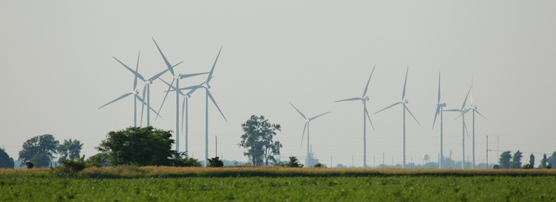
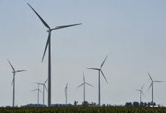
The wind blows where it wishes, and you hear the sound of it, but cannot tell where it comes from and where it goes. So is everyone who is born of the Spirit.” John 3:8 And suddenly there came a sound from heaven, as of a rushing mighty wind, and it filled the whole house where they were sitting. Acts 2:2

Slide 11
PRAY Ohio 2014
Pray for Presenting Christ
February
Pray for Promoting Growth
June
Pray for Planting Churches
October

Slide 12
A Call to Prayer
www.scbo.org/pray
Encourage
Equip
Experience

Slide 13
A Call to Prayer
Reverence
Psalm 100
Hebrews 13:15
Revelation 5:8-14

Slide 14
A Call to Prayer
Reflection
Psalm 46:10
Psalm 62:5-8
Psalm 131

Slide 15
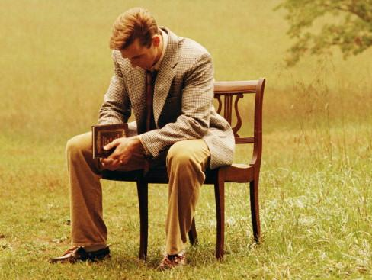
A Call to Prayer
Repentance
Amos 7:7-8
Ezekiel 14:1-14
Psalm 51
Psalm 66:18
Psalm 139:23-24
Isaiah 59:1-2

Slide 16
A Call to Prayer
Restoration
1 John 1:9
Psalm 16:11
Lamentations 3:22-23

Slide 17
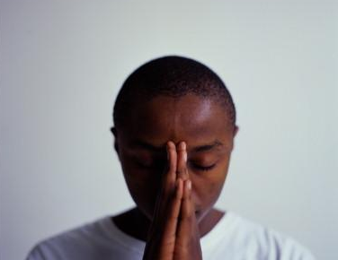
A Call to Prayer
Requests
Matthew 7:7
Philippians 4:6-7
James 5:16
1 Timothy 2:1

Slide 18
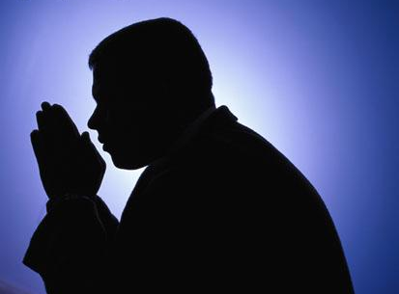
A Call to Prayer
Requests
Share your greatest personal need
Share your greatest desire for your church
Share one lost person
Share one Christian who needs restoration

Slide 19
A Call to Prayer
Requests
Focus –
Unreached and Underserved people groups
North America
World

Slide 20
A Call to Prayer
Renewal
Isaiah 40:31
Romans 12:1-2
Hebrews 10:19-25

Slide 21
A Call to Prayer
Hebrews 10:19-25 ¹⁹ Therefore, brethren, having boldness to enter the Holiest by the blood of Jesus, ²⁰ by a new and living way which He consecrated for us, through the veil, that is, His flesh,

Slide 22
A Call to Prayer
Hebrews 10:19-25 ²¹ and having a High Priest over the house of God, ²² let us draw near with a true heart in full assurance of faith, having our hearts sprinkled from an evil conscience and our bodies washed with pure water.

Slide 23
A Call to Prayer
Hebrews 10:19-25 ²³ Let us hold fast the confession of our hope without wavering, for He who promised is faithful. ²⁴ And let us consider one another in order to stir up love and good works,

Slide 24
A Call to Prayer
Hebrews 10:19-25 ²⁵ not forsaking the assembling of ourselves together, as is the manner of some, but exhorting one another, and so much the more as you see the Day approaching.

Slide 25
A Call to Prayer
Rejoicing
1 Corinthians 15:57
1 Thessalonians 5:18

Slide 26
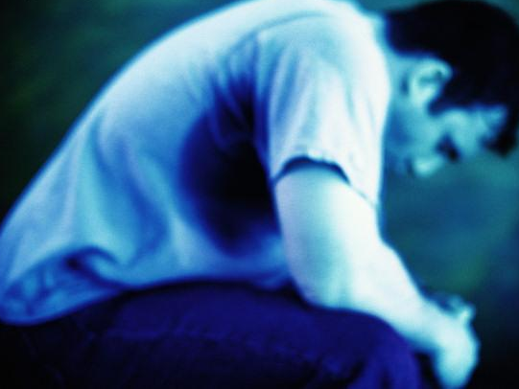
A Call to Prayer

